Slide 1
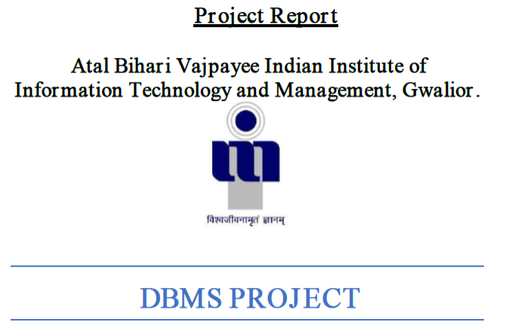

Slide 2
A customer can register to purchase an item.
After Registration, each customer will have a unique cid (customer id), email and password. A customer can purchase one or more items in different quantities.
The item can be of different category based on their type. Based on the quantity.
There will be a supplier and courier table.
A customer can order many items. Each order will have a customer Id, courier Id, supplier, productid as primary key
OVERVIEW :-

Slide 3

Customer: - Details of customers who are going to register are store.
OnlineShop: - Details of the online shops which are selling their products are stored.
Supplier: - Details of the Supplier who are sending the product are stored.
Product: - Details of product stored here (ex. type, stock, price etc.)
Orders: - Details of order given by customer are stored. (ex. order date, delivery status etc.)
Category: - Details of category in which products are categorizes are store.
7.Courier: - Details of Courier company who are going to deliver the products are stored.
ENTITY SET

Slide 4
RELATION SET
Shipment: - This relation set established relation between order placed by customer and courier service which delivers it. It is many to one relation between orders and courier.
Places: - A one to many relation between customer and places. One customer can place many orders.
Has: - Customer and supplier have many to many relationships. Different customers can order products from different suppliers.
Supplies: - ‘Supplies’ is one to many relation between supplier and product.
Belongs to: - It is many to one relation between product and category. Many products of either same or different brand may belong to same category.
Order: - It is many to many relation between customer and product.

Slide 5
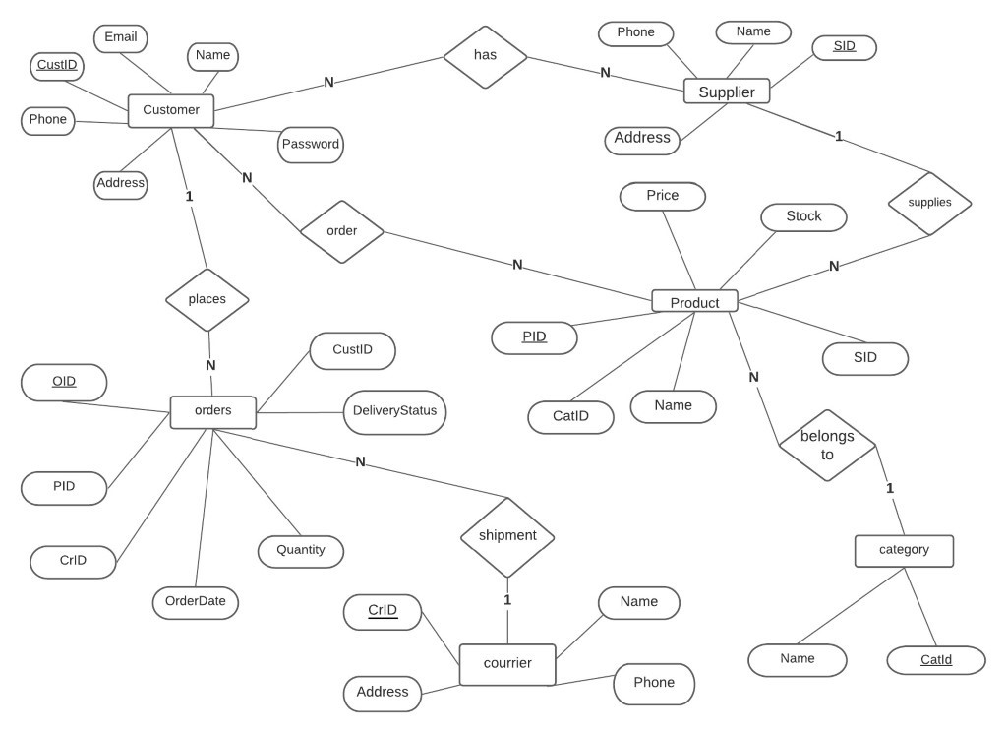
ER- DIAGRAM:

Slide 6
Initial Schema
(1St Normal Form)
Customer( CustID, Email, Name, Phone, Address, Password)
has( CustID , SID)
Supplier (SID, Phone, Name, Address)
Orders (OID, PID, Orderdate, Quantity, Deliverystatus, CustID, CrID)
Order( CustID, PID)
Product (PID, price ,Stock ,CatID , Name ,SID)
Courier(CrID, Name, Phone, Address)
Category(CatID, Name)

Slide 7
Functional Dependencies
Customer Table: -
CustID,Email—>Name,Phone, Address, Password
CustID—> Email, Phone, Name, Address --------------> Partial Dependencies
Email —>Name, Password -------------------------->
Supplier Table: -
SID—> Phone, Name, Address
Order Table: -
CrID, OID—> PID, Orderdate, Quantity, Deliverystatus, CustID ------>
CrId —> Deliverystatus-------------> Partial Dependencies
Product Table: -
PID—> Price, Stock, CatID, Name, SID
Courier Table: -
CrID—> Name, Phone, Address
Category Table: -
CatID—> Name

Slide 8

(2nd Normal Form)
Customer( CustId, Email, Name, Phone, Address)
Email( Email, Password)
Supplier (SID, Phone, Name, Address)
Orders (OID, Orderdate, Quantity, CustID ,CrId, PID)
Courier_Delivery (CrID, Delivery, Status)
Product (PID, Price, Stock, CatID, Name, SID)
Courier(CrID, Name, Phone, Address)
Category( CatID, Name)

Slide 9
Customer Table: -
CustID—> Email, Name, Phone, Address
CustID—>Email --------------------------------> Transitivity
Email—> Name -------------------------------->
Email: Table: -
Email—> Password
Supplier Table: -
SID—> Phone, Name, Address
Orders Table: -
OID—>PID, Orderdate, Quantity, CustID, CrID
Courier_Delivery Table: -
CrId—> Delivery status
Product Table:-
PID—> Price, Stock, CatID, Name, SID
PID—> Name --------------------------------> Transitivity
Name—> CatID -------------------------------->
Courier Table: -
CrID—> Name, Phone, Address
Category Table: -
CatID—> Name
Functional Dependencies

Slide 10

3RD Normal Form
Customer( CustId, Phone, Address)
Customer_Email(CustID, Email)
Email (Email, Password)
Product (PID, Price, Stock, Name)
Product_Name(Name, CatID)
There is no transition dependency in any other relation, So, all relations are in 3NF.
In all relation No, non-prime attribute can find any prime attribute so all relations are in BCNF

Slide 11
SQL AND RELATIONAL ALGEBRA QUERIES

Slide 12
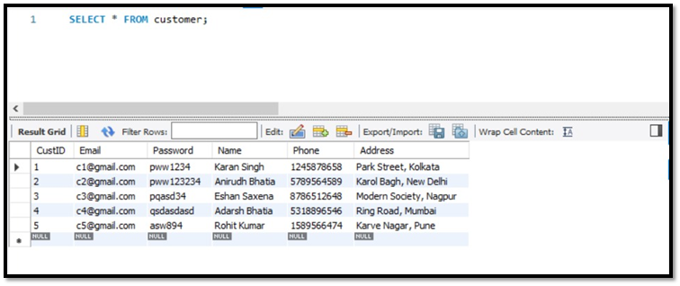
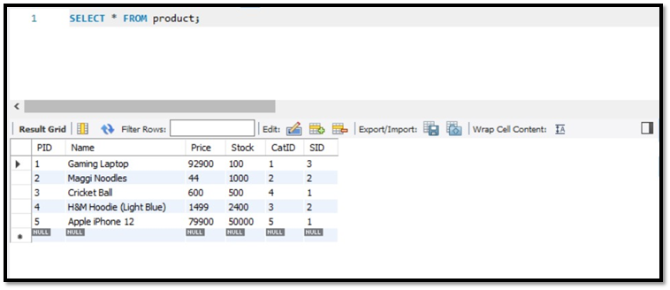
The following queries shows data/present in each table.

Slide 13
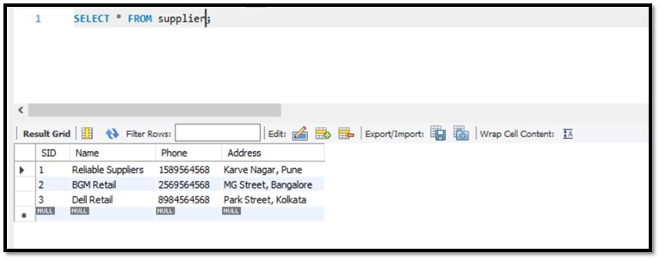
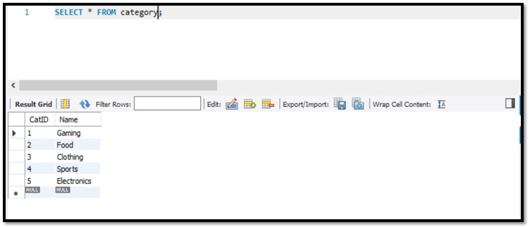

Slide 14
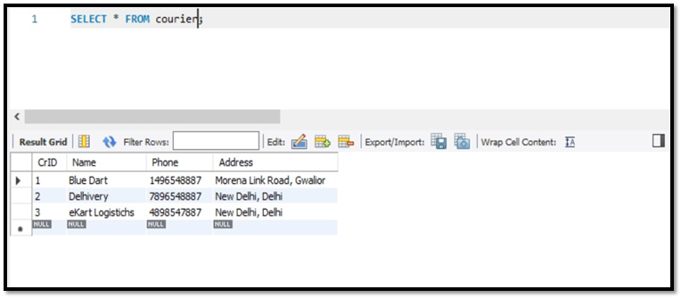
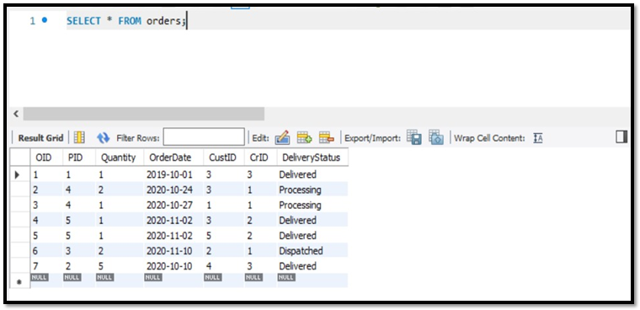

Slide 15

Relational Algebra Queries

Slide 16
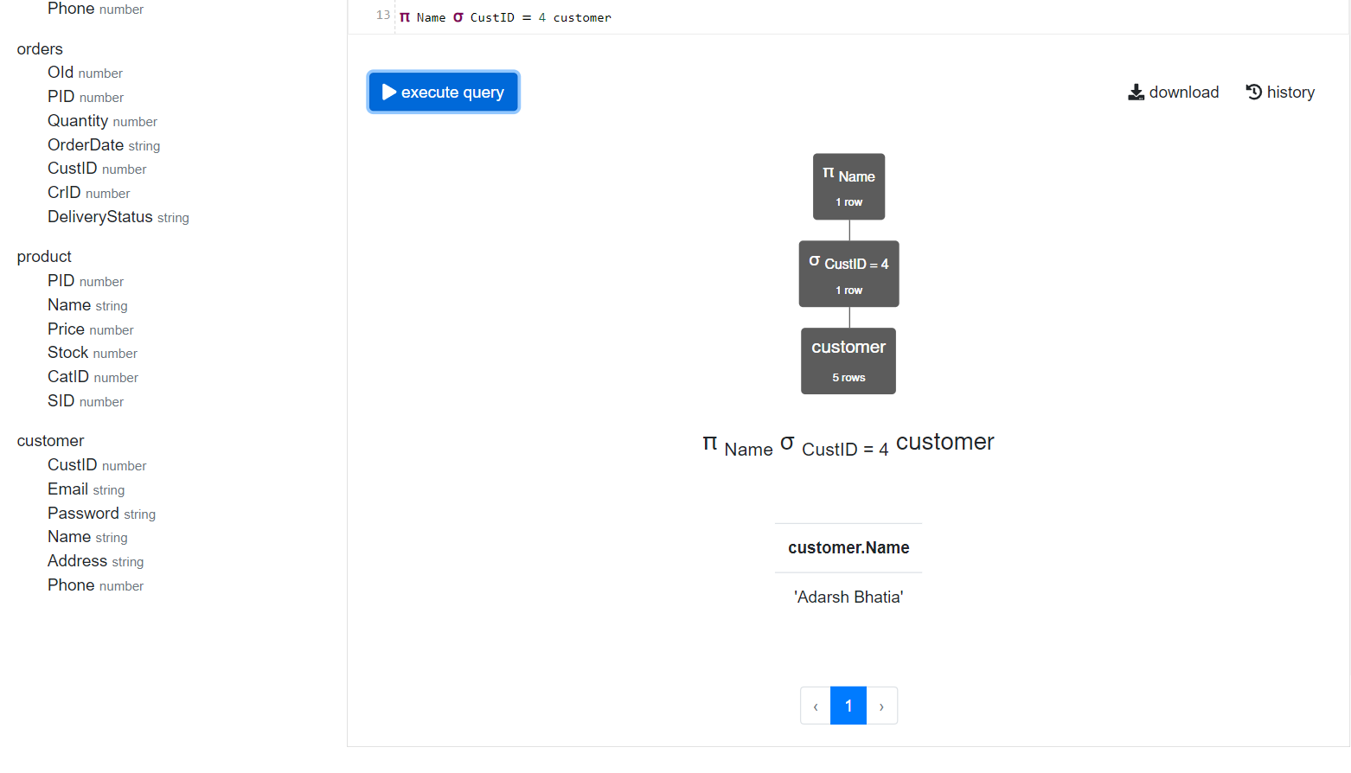
1. Write a relational algebra query to find the name of customer with CustID 4.

Slide 17
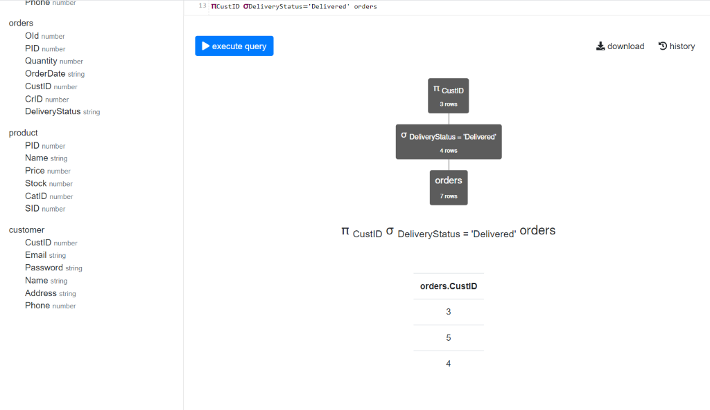
2. Write a Relational Algebra Query to find the CustID where deliverystatus is delivered.

Slide 18
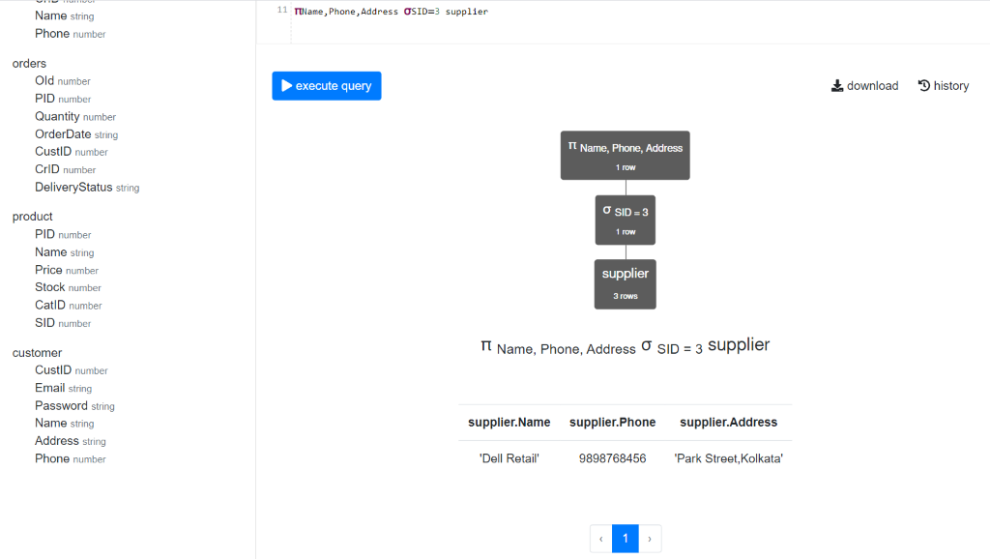
3. Write a Relational Algebra Query to find the name, phone No. and address whose SID is 3.

Slide 19
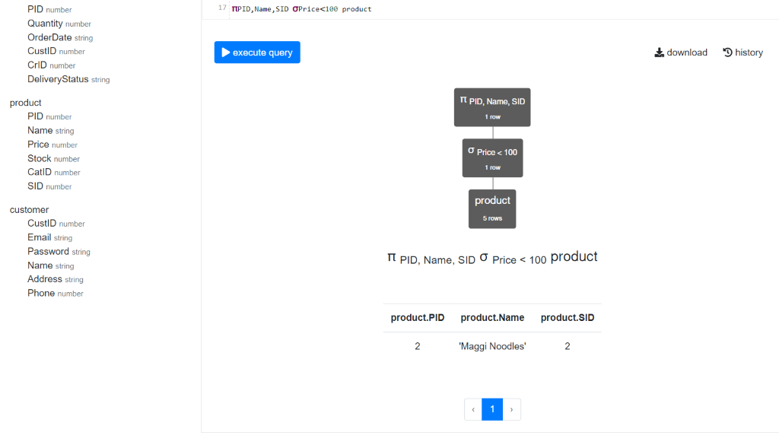
4. Write a Relational Algebra Query to find the PID and name of the product and SID where the price is less than 100.

Slide 20
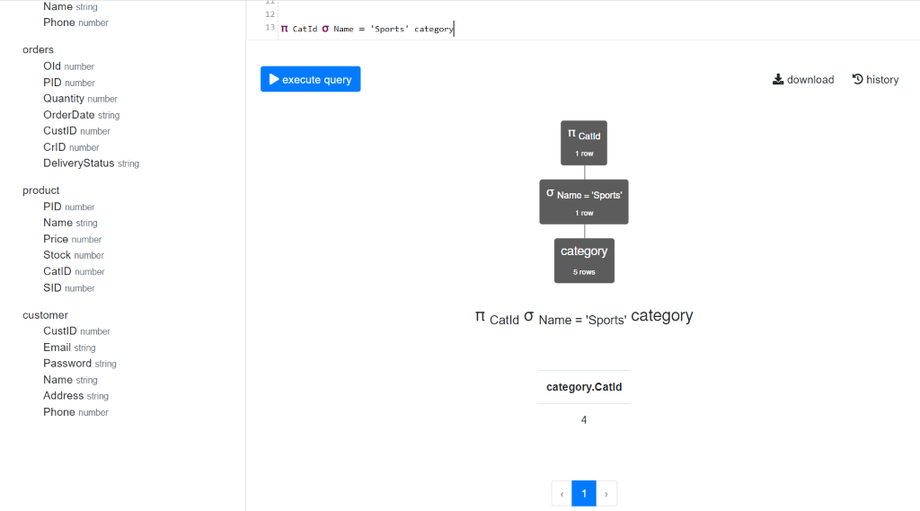
5. Write a Relational Algebra Query to find the CatID of the category sports.

Slide 21


SQL QUERIES: -

Slide 22
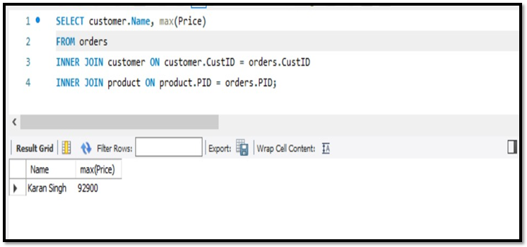
1.Write a query to find out the name of the customer with maximum price of order.

Slide 23
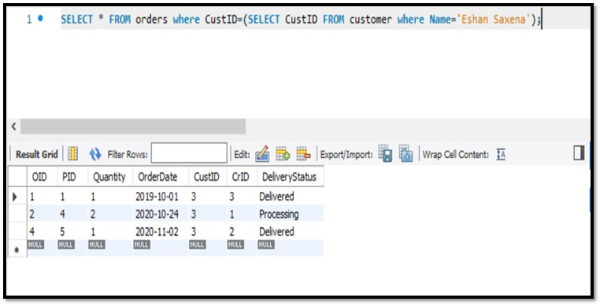
2. Write a query to find out the details of all orders placed by customer named ‘Eshaan Saxena’.

Slide 24
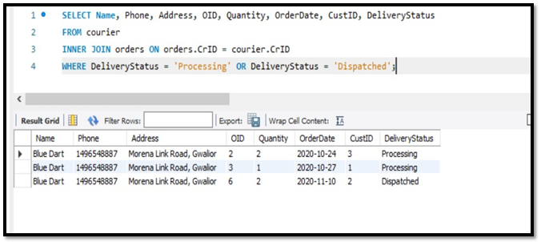
3. Write a query to find out the details of courier having pending delivery.

Slide 25
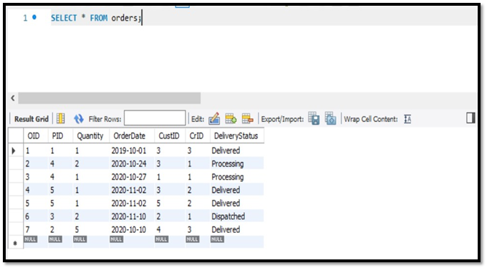
4.Write a query to find the details of all the orders placed so far.

Slide 26

THANK YOU

